Slide 1
AMBULANCE SERVICES APP DEVELOPMENT
PIP104 PROFESSIONAL PRACTICE-II
VIVA-VOCE
Batch Number: G-25
Under the Supervision of,
Dr. Srinivasan T. R
Professor, School of Computer Science Engineering & Information Science
Presidency University
20201CDV0036 | BALU ASHOK KUMAR REDDY
20201CDV0034 | KASUMURTHY VAMSI
20201CDV0028 | P BABI REDDY
20201CDV0015 | V SAI CHARAN

Slide 2
Introduction
This Android app presents an innovation solution to transform the way individual seek medical help in emergencies. Its primary goal is to offer a convenient and effective method for users to locate nearby ambulance services. Using advanced location-based services, the application swiftly identifies the nearest available ambulance services, supplying real-time information such as the ambulance’s current location. This ensures that users have crucial details about the ambulance’s whereabouts and the expected arrival time, potentially making a life-saving difference in emergency situations. The app boasts an intuitive and user-friendly interface, facilitating easy navigating for users. It allows swift and efficient ambulance booking, with users able to monitor booking details in real-time, including current location of ambulance.
This feature ensures users stay informed about their ambulance’s progress, enabling them to make indispensable for anyone requiring urgent medical attention, particularly in densely populated urban areas where challenges like traffic congestion can impede emergency services. The app streamlines the process of accessing emergency medical assistance, offering a stress-free and seamless experience, representing a significant advancement in enhancing the quality of emergency medical services.

Slide 3
Literature Review
[1]. Mohammad Abdeen; Mohamed Hossam Ahmed; Hafez Seliem; Mustafa El- Nainay; Tarek Rahil Sheltami; perfecting the Performance of Ambulance Emergency Service Using Smart Health Systems; 16- 17 December 2021. Smart health is a new paradigm that can significantly ameliorate the healthcare systems. In smart health, new seeing, calculating and communication technologies are integrated in healthcare to ameliorate the quality of service. [2]. P. Thirumoorthi; M Deeparasi; J Hariprakash; Akshayamathi M; K Premalatha; Development of Smart System for Ambulance08- 09 October 2021. Business traffic becomes a major issue in densely peopled metropolitan areas. India is the world’s second most vibrant country and has a fleetly rising frugality. In the metropolises, there's severe business traffic.
[2]. P. Thirumoorthi; M Deeparasi; J Hariprakash; Akshayamathi M; K Premalatha; Development of Smart System for Ambulance08- 09 October 2021. Business traffic becomes a major issue in densely peopled metropolitan areas. India is the world’s second most vibrant country and has a fleetly rising frugality. In the metropolises, there's severe business traffic. According to the Times of India, nearly 30 of deaths are caused by ambulances arriving late to the sanitarium. We're trying to dock the delay for the ambulance.

Slide 4
Research Gaps Identified
Integration of Artificial Intelligence and Machine Learning
Patient data security and privacy in digital age
User- Centered Design for Different Stakeholders
Standardization and Interoperability
Offline Functionality and Connectivity Issues
Public mindfulness and Education
Impact of Technological Advancements
Cultural and Societal Influences

Slide 5
Proposed Methodology
Demand Analysis
Literature Review
System Design
Technology Stack Selection
Development
Testing
Deployment
User Training and Relinquishment
Evaluation and Feedback
Nonstop enhancement

Slide 6
Objectives
Response Time enhancement
Enhanced Training and outfit
Patient Care Quality
Community Outreach and Education
Collaboration with Healthcare Providers
Risk Management and Safety Measures
Financial Sustainability
Evaluation and enhancement
Adaption to Changing requirements

Slide 7
System Design & Implementation
Objective
Requirements Gathering
Architecture Design
User Interface Design
Real-Time Location Tracking
Emergency Call Integration
Telemedicine Integration
Data Security and Privacy Measures
Interoperability with EMS Systems
Resource Allocation Optimization
User Training and Education

Slide 8
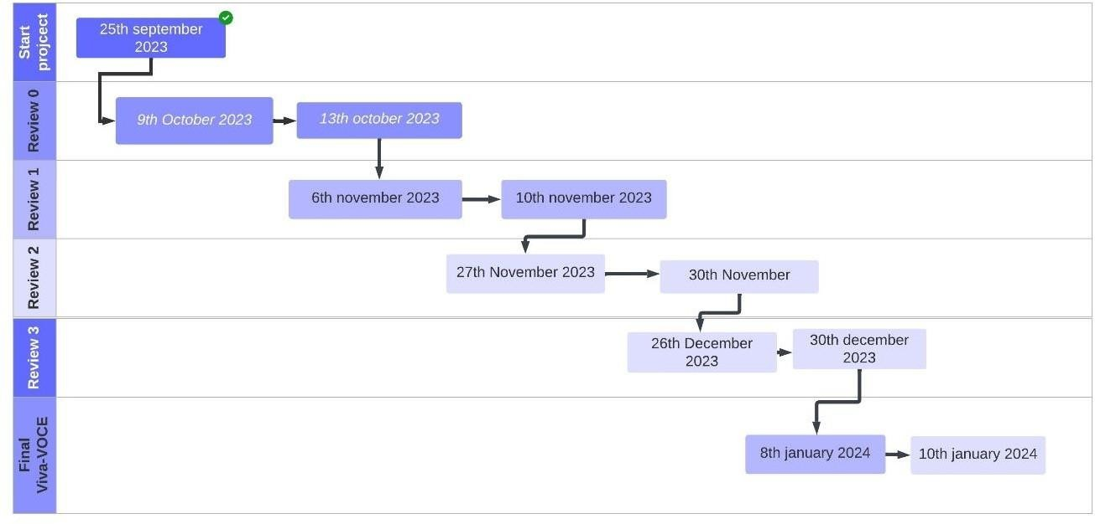
Timeline of Project

Slide 9
Outcomes / Results Obtained
Overall, the development of ambulance services apps holds immense eventuality for perfecting exigency care, reducing response times, and enhancing patient experience. Still, addressing technological challenges, ethical considerations, and data sequestration enterprises is pivotal to insure successful perpetration and indifferent access to care.
Advanced response times Apps can automate ambulance dispatch, point locales via GPS, and optimize routes, potentially leading to faster appearance times and better critical care issues. Enhanced patient experience Features like position sharing, ETA updates, and two- way communication can reduce anxiety and give pivotal information, while reserving functionalities and symptom questionnaires can streamline the process. Boosted functional effectiveness, Real- time vehicle shadowing, dispatch operation, and resource allocation tools can optimize line operation, lower functional costs, and ameliorate decision- timber. Increased translucency and responsibility Data from app operation can give precious perceptivity into ambulance service performance, easing informed decision- making and bettered resource allocation. New profit aqueducts Some apps offer ultra expensive features like precedence booking or ambulance shadowing, creating new profit sources for service providers.

Slide 10
Conclusion
The ambulance service system can encompass various functions, providing additional advantages to users. Enhanced features, such as real-time tracking of ambulances, contribute to improved administrative oversight of ambulance drivers. This not only enhances coordination between the dispatcher and ambulance driver but also ensures increased comfort for both parties. In summary, the creation of the Ambulance Services App marks a significant leap forward in the field of emergency medical services, delivering a revolutionary outcome to boost the efficiency and effectiveness of healthcare response systems. The user-friendly interface, driven by real- time geolocation shadowing and AI- driven dispatch algorithms, significantly reduces response times, icing nippy access to critical medical backing during extremities.
The app's perpetration involves a scrupulous process of planning, testing, and education, icing a flawless transition for druggies and erecting confidence in the system's trustability. The focus on sequestration and data security, with adherence to strict regulations, establishes trust among druggies, addressing enterprises related to the running of sensitive health information. Through multi-platform availability, the app caters to a different stoner base, fostering inclusivity in exigency medical backing. The optimized resource allocation and enhanced collaboration between druggies, exigency labor force, and dispatch centers contribute to a more effective and responsive exigency medical services ecosystem. As we reflect on the multifaceted issues of the Ambulance Services App development, it's apparent that the integration of advanced technologies not only streamlines the exigency response process.

Slide 11
References
[1] “.P. Arunmozhi and P.Joseph William, “Automatic Ambulance Rescue System Using Shortest Path Finding Algorithm,” in International Journal of Science and Research(IJSR),5th May 2014
[2] “RajeshwariSundhar , SanthoshHebbar and VaraprasadGolla, “Implementing Intelligent Traffic Control System for Congestion Control, Ambulance Clearance and Stolen Vehicle Detection,” in IEEE Sensors Journal, 2nd Feb 2015.CrossRef
[3] SabyasachiPatra, KarishmaVelisetty and Prathamesh Patel, “Location Based Tracking,” in International Journal of Engineering Research and Development, 12th Feb 2014.
[4] ”Ayesha Khan, ParulBhanarkar and PragatiPatil, “RSA Encryption Technique based on Geo Location,” in International Journal of Advanced Research in Computer Science
and Software Engineering, 4th Apr 2013
[5] ”GeoDataSource. (2016, August).Retrieved fromwww.geodatasource.com.
[6] ”Deepak Sharma. (2016, August) Retrieved from deepak-sharma.net.

Slide 12
Publication Details

Slide 13

Thank You

